Slide 1


Slide 2

Title : Comprehensive Water Quality Assessment and Potability Prediction using Multi-parameter Analysis
Presented by: Ruchitha M L
Date: 19-Dec-2024

Slide 3

Problem Statement : The objective of this machine learning problem is to predict whether a given set of water quality parameters meets the potability criteria or not based on the provided features.
Overview : This project focuses on analyzing the quality of water to determine its potability by examining various water quality parameters. Utilizing techniques like feature importance analysis, data balancing with SMOTE, and model evaluation metrics, we aim to build robust predictive models. The ultimate goal is to accurately classify water samples as potable or non-potable, ensuring reliable and safe drinking water assessment.

Slide 4
Data Shape: The dataset contains 2,650 rows and 10 columns.
Key Features: The key features importance of the dataset are as follows :
a) Chloramines – 0.14
b) pH – 0.13
c) Solids , Sulphate – 0.12
d) Hardness - 0.11
e) Turbidity , Trihalomethanes – 0.09
f) Conductivicity , Organic_Carbon – 0.08
Target: The target column of this dataset is Potability(0/1).
Data Overview

Slide 5
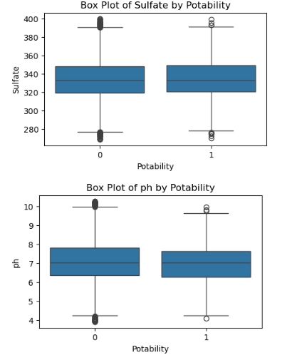
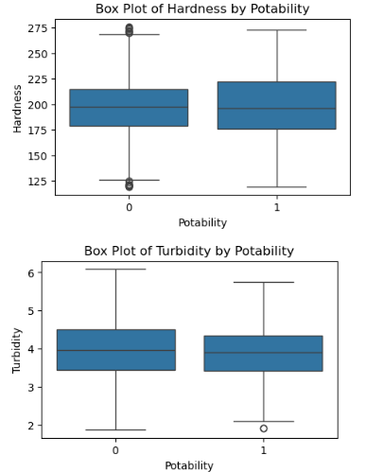
.
Data Preproccessing
Handling Duplicate Values : Duplicate records are meticulously examined and appropriately managed to ensure data integrity.
Handling Missing Values: After addressing duplicates, each column is checked for null values. Missing values are handled using the median to maintain data consistency.
Scaling : The data is scaled to ensure uniformity and improve the performance of machine learning models.
Handling Outliers : Outliers are identified and managed using the Interquartile Range (IQR) method. Visualizations are provided to display the top three most significant outliers and the category with the fewest outliers.

Slide 6
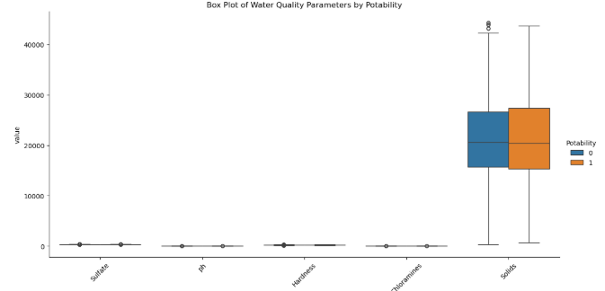
Composite Box Plot: This plot illustrates the distribution and differences of various water quality parameters across potable and non-potable water samples.
Exploratory Data Analysis - 1

Slide 7
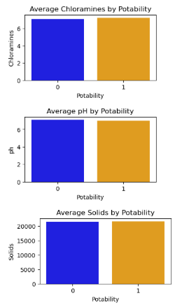
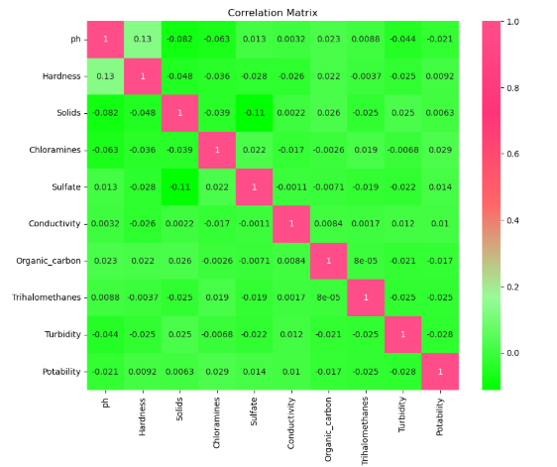
Exploratory Data Analysis - 2
Correlation Analysis
The heatmap unveiled the connections between different variables, aiding in the process of choosing the most relevant features.
Barcharts for Potability: These barcharts show average values of key water quality parameters (Chloramines, pH, and Solids) for potable and non-potable water.

Slide 8
.
.
Model Selection
Random Forest: An ensemble learning method that constructs multiple decision trees and merges them to obtain more accurate and stable predictions.
Decision Tree: A model that uses a tree-like structure of decisions and their possible consequences, including outcomes, resource costs, and utility.
Naive Bayes: A simple probabilistic classifier based on applying Bayes' theorem with strong (naive) independence assumptions between the features.

Slide 9
Model Training and Evaluation
Data Splitting:
The dataset was divided into training (70%) and testing (30%) sets to ensure model performance is evaluated on unseen data.
Hyperparameter Tuning:
Applied RandomizedSearchCV for optimal parameter selection, systematically exploring different parameter values to enhance accuracy and generalization, thereby preventing overfitting and underfitting.
Balancing the Data:
Implemented SMOTE (Synthetic Minority Over-sampling Technique) to address class imbalance, ensuring that the models are trained on a balanced dataset for better accuracy and reliability.
Evaluation Metrics:
Accuracy, confusion matrix, classification report, and ROC-AUC score were used to assess the performance of the models.

Slide 10
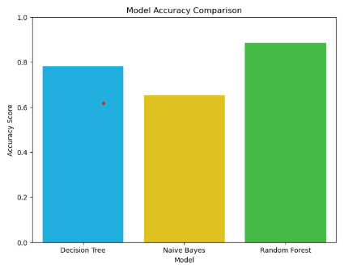
Model Performance Comparison
Random Forest: Achieved high accuracy (0.88) with robust predictions, shown through consistent cross-validation scores averaging 0.89. It provided balanced performance across precision, recall, and F1-scores, making it the most reliable model.
Decision Tree delivers clear, interpretable results with balanced precision and recall, achieving 0.77 accuracy.
Naive Bayes offers quick predictions with moderate accuracy (0.65), excelling in recall for class 1, while

Slide 11
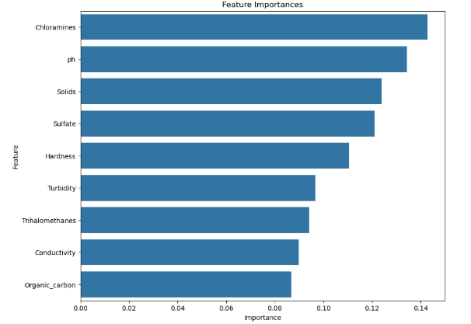
Feature Importances
The Random Forest model is utilized to calculate feature importance, identifying the most influential variables in determining water potability.
The analysis reveals that Chloramines and pH are the top contributors, with importance scores of 0.142785 and 0.134429, respectively. Other significant features include Solids and Sulfate, while Organic Carbon and Conductivity have lower influence.

Slide 12
Important Observations
.
Feature Importance: Chloramines and pH are the most influential factors in determining water potability, with Solids and Sulfate also playing significant roles.
Model Performance: Random Forest model demonstrated the highest accuracy and robust predictive capability, making it the most reliable model for this dataset.
Visual Representation: Bar plot comparison of model accuracies highlighted the superior performance of the Random Forest model, followed by Naive Bayes and Decision Tree.

Slide 13
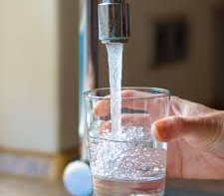

Thank you

Slide 14


